Slide 1
CAR Champion Calibration Meeting CAR Review
Team “A”
Kyle Huang(CAR 163916135 Finding)
Matt Marotto (CAR 163916189 Finding)
Mel Fehrenbacher (CAR 163915755 Observation)
Brian Mahoney(Exemplary CAR)

Slide 2
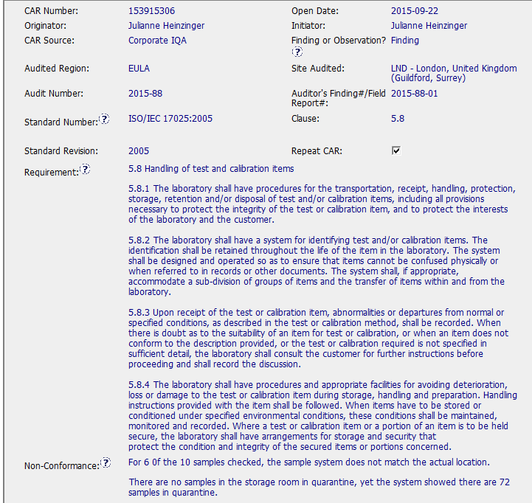
Exemplary CAR -153915306
All fields have been appropriately fulfilled
Well defined non-conformance and objective evidence

Slide 3
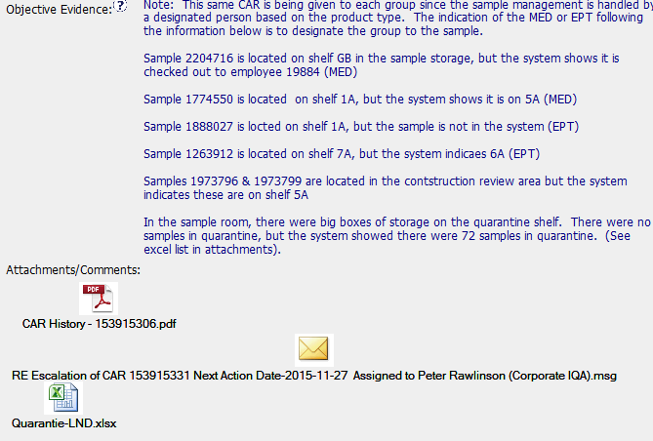
Exemplary CAR -153915306
Detailed objective evidence

Slide 4
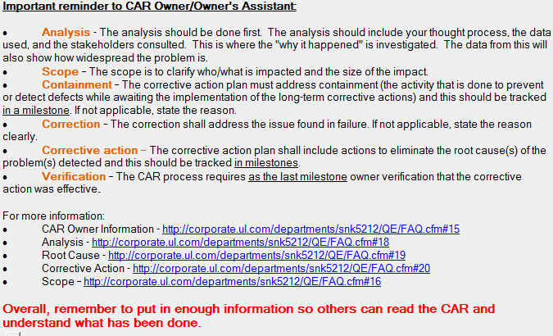
Exemplary CAR - 153915306
Correct guidance to CAR Owner and to FAQ # 15

Slide 5
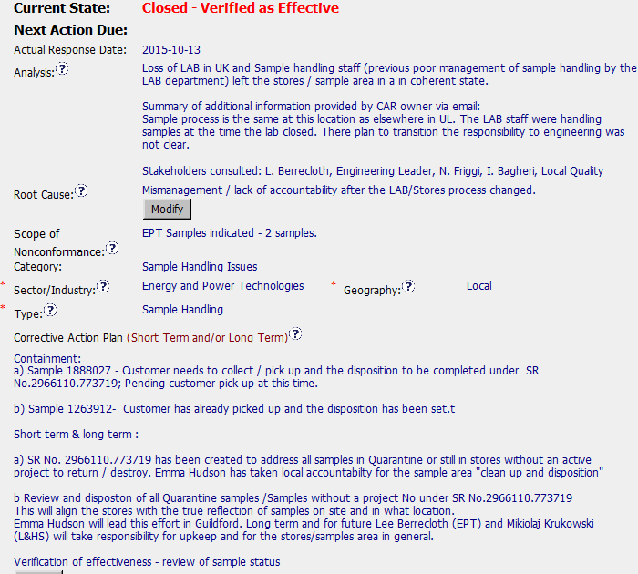
Exemplary CAR - 153915306
Very clear analysis to arrive at the root cause

Slide 6
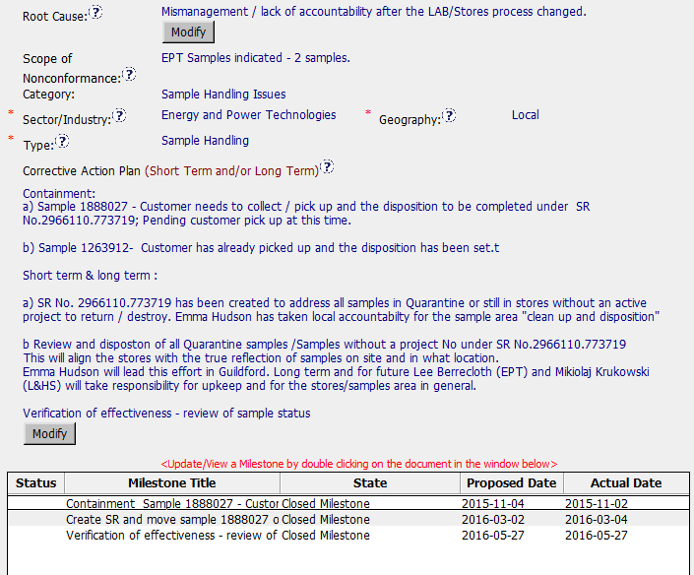
Exemplary CAR - 153915306
Root Cause is directly related to the Non-conformance
Corrective action Plan and milestones correctly address the non conformance

Slide 7
Exemplary CAR – 153915306 CBS
INTEGRITY: Initiative & Decision Making / Analyzing & Problem Solving
Facilitates progression of the CAR through closure: extensions, escalations, reassignments, etc. (+)
Accurately completes the administrative fields within the CAR such as root cause category, process impacted, geography, etc. (+)
Acts on CARs within the required timeframe (+)
Most appropriate ‘category’, ‘type’, ‘geography’ are selected (+)

Slide 8
Exemplary CAR – 153915306 CBS
COMPETIVENESS: Customer Focus / Achieve Business Results / Flexibility
Assists customers as they address all aspects of the CAR – analysis, root cause statement, milestone, containment, verification, etc. (+)
Verifies CARs timely (+)
Analysis shows clear path to root cause and scope; stakeholders identified (+)
Root cause statement is succinct, reasonable, complete (+)
Corrective actions fix the objective evidence and other problems found; address entire root cause and scope. (+)
Milestones address containment & owner’s verification; completed per milestone expectations(+)
Verification per requirements (+)
COLLABORATION: Leading & Engaging / Teamwork / Communication
Provides pertinent feedback at appropriate times; shares information and keeps others informed (+)

